Slide 1
OUR DBMS PROJECT

Slide 2
HAVE YOU EVER WONDERED HOW TO STORE AND READ DATA EFFICIENTLY?

Slide 3
OUR PROJECT PROVIDES YOU THE FOLLOWING FEATURES!

Slide 4
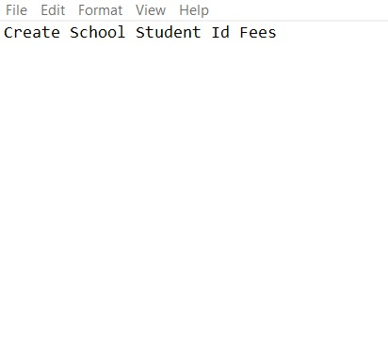
Create a table
- Each column can be specified.
- The sheet can be unique.

Slide 5
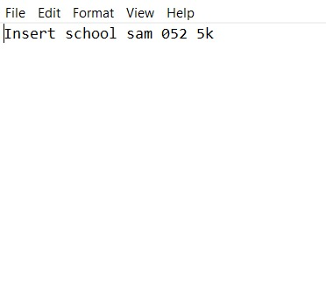
2. Insert a row
- Any number of rows can be added.

Slide 6
3. Read All
- All the elements in that unique sheet can be read.

Slide 7
4. Read Row
- An entire row can be read with a given value from that row.

Slide 8
THANK YOU!

